Slide 1

Parallel Word Count System
Distributed Computation Engine via gRPC and MPI Backend
PHASE 3: FAULT TOLERANCE & STREAMING

Slide 2




EXECUTIVE SUMMARY
Core Integration
Fault Tolerance
Combines Python gRPC for reliable API delivery with C++ MPI for high-performance parallel computation on the backend.
Features a replicated service model with automated client-side retries and idempotency through unique request identifiers.

Slide 3
THE CHALLENGE
— Project Requirement Overview
"Traditional batch processing can no longer support applications requiring low latency, continuous data ingestion, and scalable processing."
— Project Requirement Overview

Slide 4

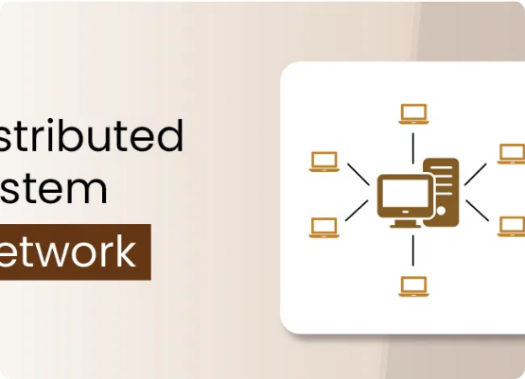
SYSTEM ARCHITECTURE
Client: Orchestrates requests and collects performance metrics.
gRPC Server: Acts as the interface gateway between user and backend.
MPI Engine: Distributes word counting tasks across multiple processes.

Slide 5






TECHNOLOGY STACK
Python
C++ / MPI
Spark
API implementation and gRPC Server management.
Performance-critical parallel word count engine.
Real-time structured streaming pipeline.

Slide 6

01
Backend Mechanisms
Parallel Processing & Distributed Logic

Slide 7
REQUEST LIFECYCLE
Ingestion: Client sends unique request_id and text payload.
Persistence: Server writes input text to a temporary local file.
Execution: MPI engine starts via an external command process.
Retrieval: Server reads the result file and caches it in memory.

Slide 8
ENSURING IDEMPOTENCY
IDEM
To prevent inconsistent results during network failures, every request is tracked via an in-memory cache.
Duplicate request_id entries are detected instantly, allowing the server to return previous results without re-computation.
RELIABILITY CORE

Slide 9

MPI ENGINE DEEP DIVE
Parallel Counting
The system splits large text files (e.g., big.txt) into chunks. MPI ranks process these chunks concurrently, performing a final reduction to aggregate total counts.

Slide 10
02
Fault Tolerance
Replication and Failover Strategies

Slide 11


SERVICE REPLICATION
Replica 01
Replica 02
Endpoint: localhost:50051
Endpoint: localhost:50052
Primary serving port for initial client requests.
Secondary fallback port for high availability.

Slide 12

FAULT-AWARE CLIENT
The client maintains a list of all available replicas. Upon detecting a connection timeout or server crash, it automatically rotates to the next available endpoint.
Zero Manual Intervention: The system maintains continuous operation even during individual node failures.

Slide 13
03
Performance & Logs
Experimental Evidence of Resilience

Slide 14


CASE: EXECUTION FAILURE
Platform Incompatibility
A failure was injected where the MPI binary was incompatible with the environment. The gRPC server remained alive, returned internal errors, and triggered client retries.

Slide 15
OBSERVED RESILIENCE
Service Stability: The gRPC wrapper prevented system-wide crashes during backend failures.
Automated Recovery: Client retry logic correctly identified failed requests and redirected traffic.
Data Integrity: Metrics collected in test_metrics.csv confirmed all requests were eventually fulfilled.

Slide 16
SYSTEM METRICS
Performance Metric | Measured Value | Operational Impact
Average Latency | 201.52 ms | Near real-time response capability
Throughput | 0.75 req/sec | Steady handling of distributed workloads
Recovery Time | 0.75 seconds | Rapid failover to active replicas

Slide 17
04
Advanced Streaming
Spark Structured Streaming Integration

Slide 18
REAL-TIME PIPELINE
Ingestion
Streaming
UDF Integration
Checkpoints
Spark Data Generator continuously produces text events.
Spark Structured Streaming processes micro-batches.
Spark invokes gRPC logic via custom User-Defined Functions.
Fault tolerance is ensured through Spark checkpointing.

Slide 19



SYSTEM BENEFITS
Scalability
Modularity
Production Ready
Modular design allows adding servers or MPI nodes as needed.
Decouples business logic from the core streaming engine.
Architecture mimics production-grade distributed pipelines.

Slide 20
Questions?
Parallel Word Count System Performance Analysis
www.parallel-wc-project.io

